Slide 1

SMART PLANT CARE SYSTEM
By:-
20/ECE/131 – SACHIN SAURAV
20/ECE/143 – SHIVA CHOUDHARY
20/ECE/170 – SUCHISMITA GHOSH
20/ECE/181 – SHUVAJIT AKHULI
Under The Supervision of:-
Dr. Avishek Das
Assistant Professor, Dept. of ECE
A Project thesis Submitted to Haldia Institute of Technology
In Partial Fulfilment of the Requirements for Degree of
B. Tech in Electronics & Communication Engineering,
Maulana Abul Kalam Azad University of Technology,
Formerly known as West Bengal University of Technology.

Slide 2
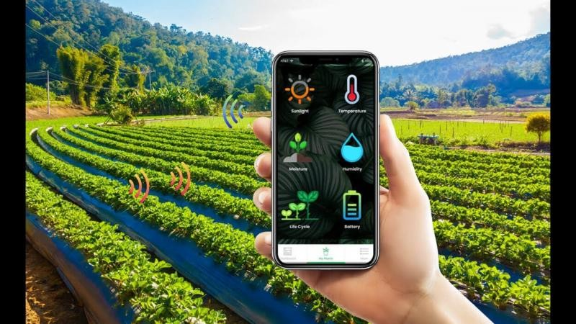
SMART PLANTATION SYSTEM
“The Smart Plant Care System, powered by Arduino, represents a groundbreaking leap in the realm of precision agriculture and horticulture.”

Slide 3
Acknowledgement
We would like to extend our sincere gratitude to our esteemed Assistant professor, Dr. Avishek Das, for their invaluable guidance, unwavering support, and insightful suggestions throughout the duration of this project. Their expertise in the field of Electronics has been instrumental in shaping our understanding of the various components used in the project and enhancing our skills. We are also immensely grateful to Haldia Institute Of Technology for providing us with the platform and resources to undertake this project. The conducive learning environment and state-of-the-art facilities at our college have played a pivotal role in our academic growth and overall development.
We would like to express our appreciation to all the faculty members and staff of the Electronics and Communication Engineering Department for their constant encouragement and assistance. Their unwavering dedication to nurturing students' talent and fostering a conducive learning atmosphere has been commendable .This project has been an enriching experience, allowing us to delve deeper into the fascinating world of IOT based projects. The knowledge and skills gained during this project will undoubtedly shape our future endeavours in the field of Electronics.
Thank you once again to our esteemed Assistant Professor, Dr. Avishek Das, and Haldia Institute of Technology, for their invaluable contributions, which have made this project a fulfilling and rewarding experience.

Slide 4
Objective
The primary objective behind the Smart Plant Care System utilizing Arduino and various
sensors is to revolutionize the traditional paradigms of plant care by integrating advanced
technology into the process. This system aims to create an intelligent and automated approach
to nurturing plants, ensuring optimal growth conditions through real-time monitoring of
crucial environmental factors. By employing Arduino's versatility and compatibility with a
diverse array of sensors, the objective is to empower users with the ability to make informed
decisions based on accurate data. The system seeks to streamline and enhance plant care
practices, promoting resource efficiency, reducing manual intervention, and ultimately
fostering healthier and more robust plant growth. Whether applied in agriculture, indoor
gardening, or urban farming, the Smart Plant Care System aspires to usher in a new era of
precision and sustainability in plant cultivation practices.

Slide 5
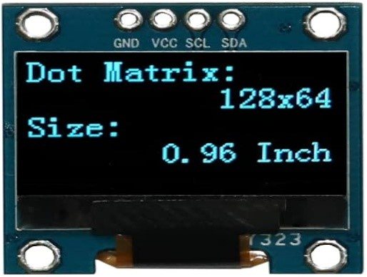
SENSORS USED:-
OLED SCREEN
OLED screens with I2C (Inter-Integrated Circuit) communication, commonly used in Arduino projects, offer a convenient and efficient way to integrate high-quality displays into electronic projects.
I2C is a serial communication protocol that enables multiple devices to communicate with each other using only a few wires.
OLED screens utilizing I2C in Arduino projects simplify the wiring and reduce the number of required pins, making the integration process more straightforward.

Slide 6
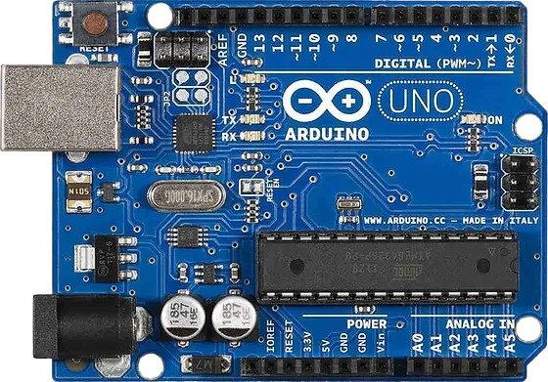
2. ARDUINO UNO
The Arduino Uno is a popular and versatile microcontroller board that forms the cornerstone of the Arduino platform.
The board features a set of digital and analog input/output pins, along with various communication interfaces like USB, UART, and I2C.
The Arduino Uno is known for its simplicity, making it an excellent choice for beginners, while its extensive community support and rich ecosystem of libraries.

Slide 7
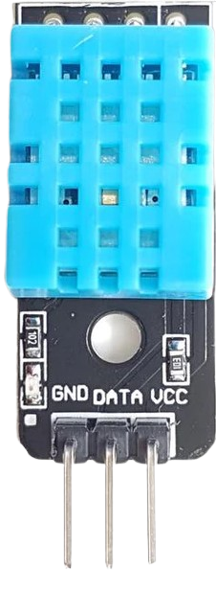
3. DHT Level Temperature And Humidity Sensor
The DHT series temperature and humidity sensors, commonly used in Arduino projects, are compact and reliable devices that measure both temperature and humidity levels in their environment.
Examples include sensors like the DHT11 and DHT22.
. These sensors utilize a combination of a thermistor and a humidity sensing element to provide accurate readings.

Slide 8
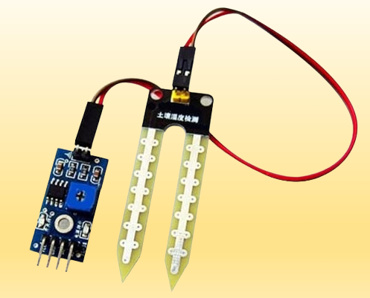
4. MOISTURE SENSOR
A soil moisture sensor used in Arduino projects is a key component for monitoring and managing soil conditions in various applications.
These sensors typically utilize a pair of probes that are inserted into the soil to measure its moisture content.
As the soil's water content changes, it affects the electrical conductivity between the probes.

Slide 9
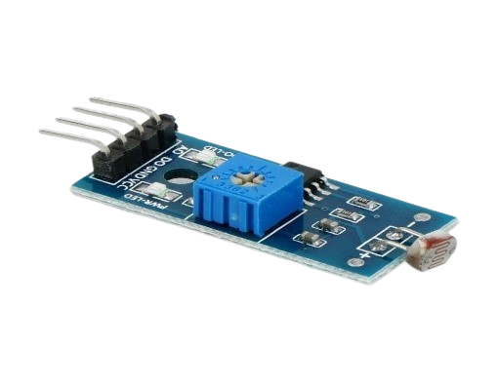
5. LIGHT SENSOR
A light sensor used in Arduino projects is a device designed to measure the intensity of light in its surroundings.
These sensors are integral to various applications, including home automation, robotics, and environmental monitoring.
Arduino-compatible light sensors typically operate on the principle of photoresistors or photodiodes, where the electrical resistance changes in response to the amount of incident light.

Slide 10
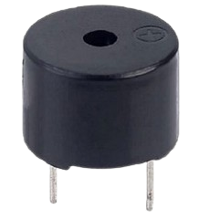
6. BUZZER
A buzzer used in Arduino projects is an electronic component designed to produce audible sounds or tones when an electrical signal is applied.
Buzzers are commonly employed to provide audio feedback in various Arduino applications, from simple alarms and notifications to more complex interactive projects.
Arduino enthusiasts can easily integrate buzzers into their circuits, leveraging the simplicity of the tone() function in the Arduino IDE to generate different frequencies and durations of sound.

Slide 11
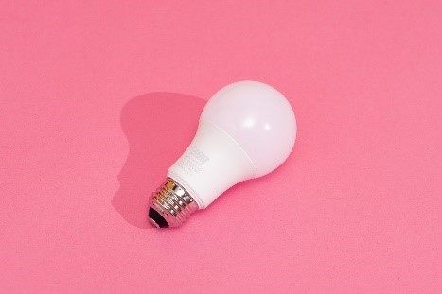
7. GROWTH LIGHT
Growth lights used in Arduino projects refer to lighting systems designed to provide optimal conditions for plant growth and cultivation.
These lights typically utilize specific wavelengths of light, such as red and blue, which are essential for photosynthesis.
When integrated with Arduino microcontrollers, growth lights can be controlled to create customized lighting schedules for different plant species, growth stages, or environmental conditions.

Slide 12
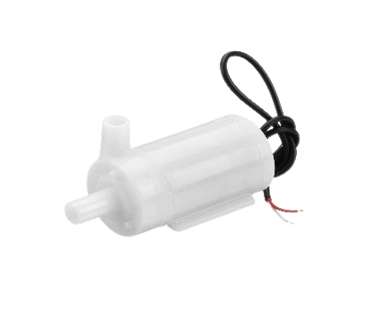
8. WATER PUMP
A water pump used in Arduino projects is an electronic device designed to move water efficiently based on the commands received from an Arduino microcontroller.
These pumps are widely employed in various applications, such as irrigation systems, hydroponics, and aquariums.
By connecting the water pump to an Arduino, users can automate and control the water flow in their projects.

Slide 13
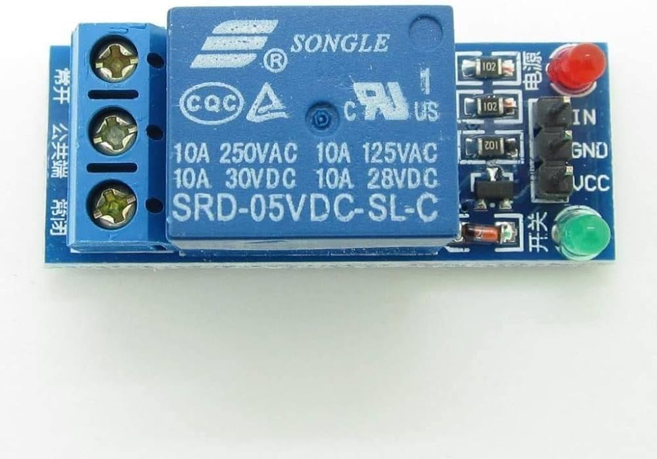
9. SINGLE CHANNEL RELAY
A single-channel relay used in Arduino projects is a versatile electronic switch that allows the Arduino microcontroller to control high-power devices or circuits with lower voltage levels.
The relay typically consists of a coil, an electromagnetically controlled switch, and a set of terminals.
When an electrical signal is applied to the coil from the Arduino, it triggers the switch to open or close, thereby controlling the connected load.

Slide 14
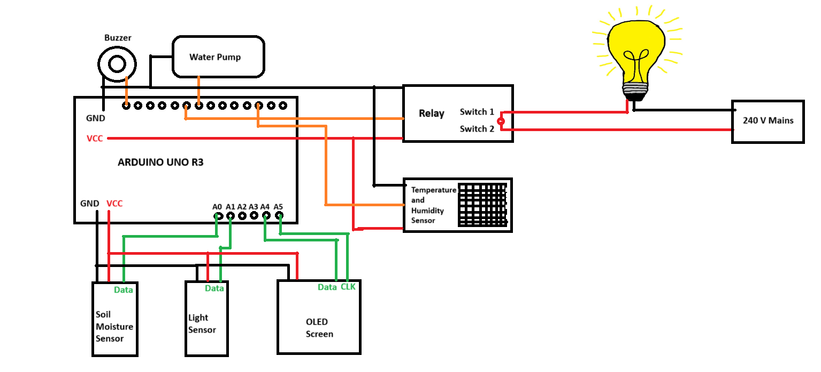
PIN DIAGRAM

Slide 15
WORKING PRINCIPLE
RED STANDS FOR VCC
BLACK STANDS FRO GND
GRREN STANDS FOR ANALOG DATA
ORANGE STANDS FOR DIGITAL DATA
Working of the smart plant care system
All the black connections are ground in the circuit diagram.
There are 3 GND pins in the Arduino and we can connect to any one of the 3 GND pins. GND is connected to each and every sensor in the circuit. All the red connections means the VCC which means the power supply.
All the sensors used in the circuit require only 5 volt of current to function and that 5 volt of current will be provided by the Arduino itself through the medium of VCC.
ANALOG PINS
Soil moisture sensor will give a range of value so it is connected to analog pin. Light sensor will also give a range of values so it is connected to analog pin.
Now we have connected Oled screen to two analog pins. Basically Oled screen has 4 pins VCC, GND ,SCL and SDA. SCL is the clock pin over here . As Oled screen is based on an old technology so the function of SCL is to synchronize the pixels on the screen. SDA is the data pin where the corrresponding pixels which have recieved the signal will light up . and both the pins has to be analog pins as said by the manufacturer of Arduino and that two pins will be A4 and A5.

Slide 16
DIGITAL PINS
Buzzer is connected to digital pins because a buzzer can perform only two operations either it will ring or it won’t just like a digital signal giving output either 0 or 1. So basically it also works as a digital device. Similarly for relay if there is enough grow light the bulb will not go on and if there is not enough light the bulb will go on now comes the interesting fact that why we have connected temperature and humidity sensor to the digital pins . So we have used DHT 11 sensor over here if we closely look at the sensor there are 3 pins on the sensor. basically GND, DATA, VCC. Here the data pin works in a different manner. There is a chip inserted in the data pin of the sensor. ADC chip which converts analog signals to digital signals and therefore gives output in the form of digital signals. No other sensor has an ADC in built inside the sensor. If the moisture in the soil will be less the soil moisture sensor will detect it and the water will get pumped in the soil. If the water supply gets exhausted then the buzzer will go on indicating that the plant needs more water.

Slide 17
REAL LIFE APPLICATIONS
Smart Agriculture: In large-scale farming, the smart plant care system can be employed to monitor soil moisture levels, temperature, and light conditions. This data can be used to automate irrigation systems, ensuring crops receive the right amount of water and creating an optimized environment for plant growth. Smart agriculture, facilitated by the smart plant care system using Arduino, represents a transformative approach to farming that leverages technology to enhance efficiency, optimize resource usage, and improve overall crop yield.
Indoor Gardening: In indoor environments, the system can be utilized to create ideal conditions for potted plants or hydroponic setups. Arduino can control grow lights, regulate water pumps, and manage ventilation systems, providing precise environmental control for optimal plant health. Indoor gardening is revolutionized by the implementation of the smart plant care system using Arduino, creating an intelligent and automated environment for optimal plant growth.
Urban Farming: In urban settings or limited spaces, the smart plant care system allows for efficient cultivation on rooftops, balconies, or small gardens. Arduino-based automation helps overcome space constraints by maximizing the use of available resources. This innovative application of Arduino technology transforms indoor gardening into a more accessible and efficient endeavor, catering to hobbyists and plant enthusiasts seeking to cultivate thriving greenery within their homes.
Home Gardens: For individuals with home gardens, the system can be implemented to automate watering schedules, monitor soil conditions, and adjust lighting. This ensures that even hobbyist gardeners can maintain healthy plants without constant manual intervention. Home gardening experiences a technological upgrade with the implementation of the smart plant care system using Arduino, offering an intelligent and user-friendly approach to nurturing plants.

Slide 18
CONCLUSION
The smart plant care system built with Arduino and various sensors represents a revolutionary approach to plant cultivation, combining technology and agriculture for optimal growth. By integrating sensors that monitor critical environmental factors like soil moisture, temperature, and light levels, the Arduino microcontroller processes real-time data to facilitate intelligent decision-making. This system enables automated and precise control over essential parameters, triggering actions such as irrigation, nutrient delivery, and climate adjustments. Whether deployed in smart agriculture for large-scale farming, indoor gardening setups, urban farming initiatives, or home gardens, the versatility of this Arduino-based system empowers users to create tailored solutions for diverse plant care needs. With its user-friendly interface and adaptability, the smart plant care system epitomizes the intersection of innovation and horticulture, ushering in an era of efficient, data-driven, and sustainable plant cultivation practices.

